Slide 1

Rainfall Prediction using Machine Learning - Python
This presentation will explore the development of a rainfall prediction system using machine learning in Python. We'll delve into the problem, objectives, existing solutions, and our proposed system, including architecture, modules, outputs, and future directions.

Slide 2
Problem Statement
Accurate rainfall prediction is crucial for agriculture, water management, and disaster preparedness.
Traditional methods often rely on historical data and statistical models, which may not always capture dynamic weather patterns.
Machine learning offers a promising alternative for improving prediction accuracy, particularly in regions with complex weather conditions.
The goal is to build a system that leverages historical weather data and machine learning algorithms to predict rainfall with greater precision.

Slide 3
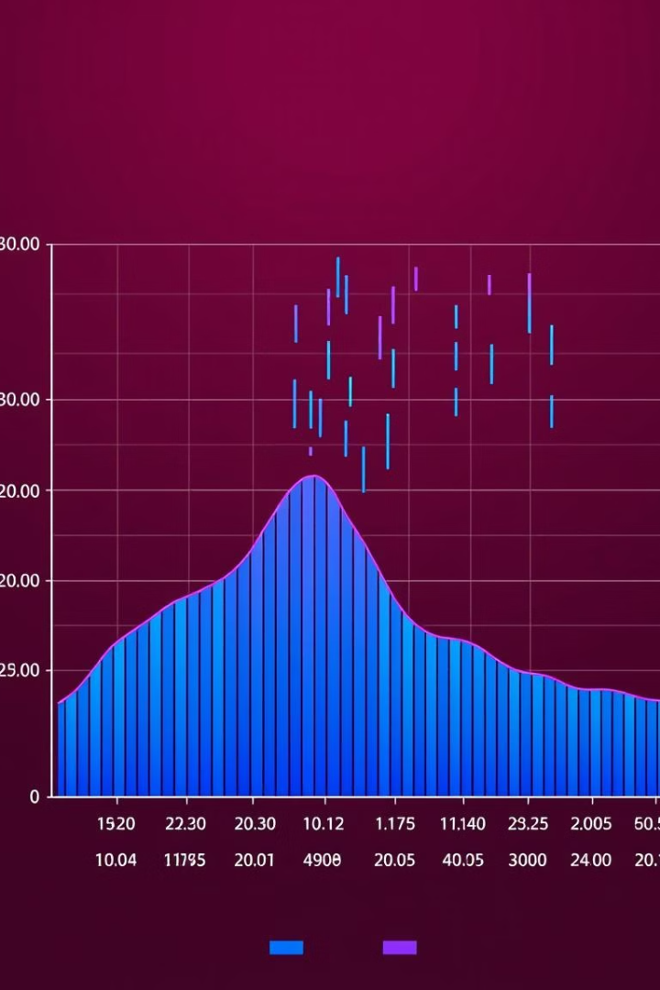
Objective
1
Develop a Machine Learning Model
2
Evaluate Model Performance
Create a robust model capable of predicting rainfall based on historical weather data.
Measure the accuracy, precision, and reliability of the model using appropriate metrics.
3
Implement a User-Friendly Interface
4
Enhance Prediction Accuracy
Design an intuitive interface for users to input data and receive rainfall predictions.
Explore techniques to optimize the model and improve the accuracy of rainfall predictions.

Slide 4





Abstract
Rainfall Prediction
1
Leverage machine learning for enhanced accuracy.
Data Collection and Preprocessing
2
Gather relevant weather data and prepare it for analysis.
Model Selection and Training
3
Choose a suitable algorithm and train it on the preprocessed data.
Prediction and Evaluation
4
Generate rainfall predictions and assess the model's performance.
Implementation and Deployment
5
Develop a user-friendly interface and deploy the system.

Slide 5
Existing System
Existing rainfall prediction systems rely heavily on statistical models and historical data.
They often struggle to predict rainfall accurately, particularly in regions with dynamic weather patterns.
Limitations include a lack of adaptability to changing weather conditions and potential biases in historical data.
The need for more sophisticated and accurate prediction methods is evident, particularly in light of climate change.

Slide 6
Proposed System
Machine Learning Approach
1
Employ machine learning algorithms for improved prediction accuracy.
Data Acquisition and Preparation
2
Gather diverse weather data from multiple sources and pre-process it.
Model Training and Evaluation
3
Train and evaluate the model using historical weather data and performance metrics.
User Interface Development
4
Create an intuitive interface for users to access predictions easily.

Slide 7
Architecture Diagram
Data Acquisition
Data Preprocessing
Model Training
Retrieve weather data from various sources, such as meteorological stations, satellite imagery, and historical records.
Cleanse, transform, and prepare the data for model training, handling missing values and inconsistencies.
Select and train a suitable machine learning algorithm on the preprocessed data, optimizing parameters for maximum accuracy.
Prediction Engine
User Interface
Use the trained model to generate rainfall predictions based on user-provided inputs, such as date, location, and other relevant parameters.
Design an interface for users to interact with the system, input data, and receive predictions in a user-friendly manner.

Slide 8
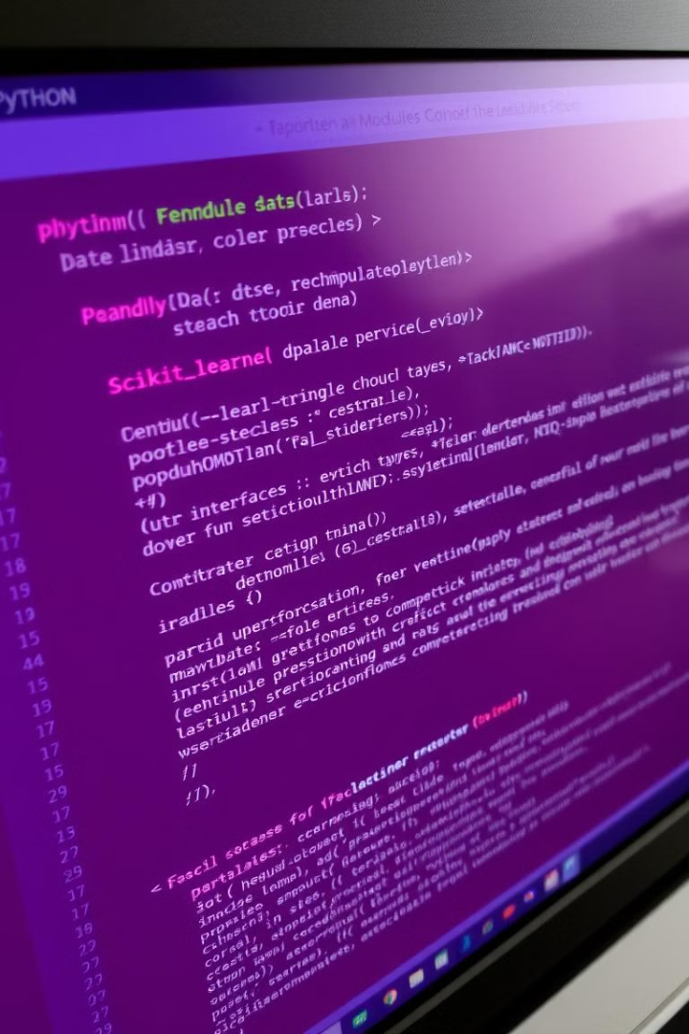

Modules
Data Acquisition and Storage
Data Preprocessing and Feature Engineering
Implement modules to collect and store weather data from various sources, ensuring data quality and consistency.
Develop modules to cleanse, transform, and engineer features from the raw data, enhancing model performance.
Machine Learning Models
User Interface
Integrate modules for different machine learning algorithms, such as linear regression, support vector machines, or neural networks.
Develop user-friendly modules for inputting data, receiving predictions, and visualizing results.

Slide 9
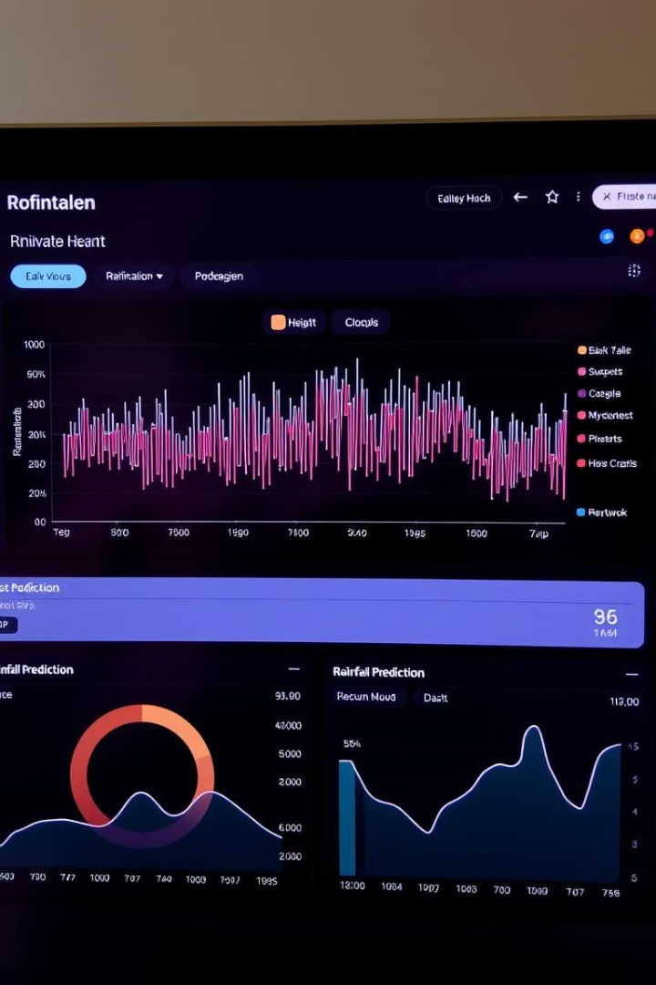
Outputs
1
2
Rainfall Predictions
Visualization
Generate accurate rainfall predictions for specific locations and time periods.
Provide visual representations of rainfall predictions, facilitating easier understanding.
3
4
Performance Metrics
Alerts
Display metrics like accuracy, precision, and recall, evaluating model performance.
Send alerts to users based on predicted rainfall patterns, enabling proactive preparation.

Slide 10

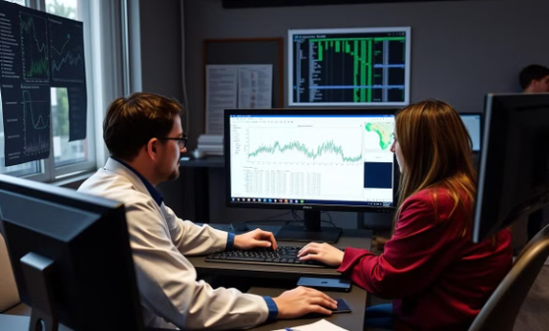
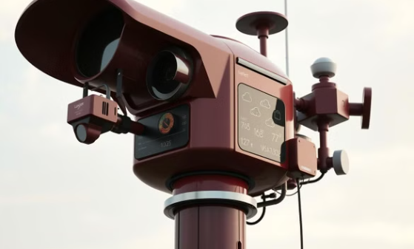
Conclusion and Future Work
This rainfall prediction system demonstrates the power of machine learning for improving weather forecasting. The system leverages historical weather data and sophisticated algorithms to provide accurate and timely predictions, supporting decision-making in agriculture, water management, and disaster preparedness. Future work will focus on exploring new data sources, integrating advanced algorithms, and enhancing the user experience.

